Slide 1

WELCOME TO DATA WORLD

Slide 2

STUDENT DATABASE
MANAGEMENT
SYSTEM
LIBRARY MANAGEMENT TOOL
BY TEAM HYPOCRITE
CSE-2100 OBJECT ORIENTED PROGRAMMING PROJECT
DATE:- 07-04-2024

Slide 3




DEVELOPER IDENNTITY
MUNTASIR BILLAH NAKEEB
ID: 2109016
DEPT.: ECE
UNIVAERSITY: KHULNA UNIVERSITY OF ENGINNERING AND TECHNOLOGY, KHULNA, BANGLADESH

Slide 4
WHAT IS STUDENT MANAGEMENT?

Slide 5
PROJECT OVERVIEW
WHAT IS STUDENT MANAGEMENT?
Student Management System is a solution tool that is designed to track, maintain and manage all the data generated by a School

Slide 6

PROJECT OVERVIEW
TO CREATE A SIMPLE AND EASY TO UNDERSTAND MANAGEMENT TOOL
USING OOP CONCEPT TO CREATE A TOOL WHICH IS EASY TO HANDLE
TO EASE COMPLICATIONS FOR AUTHORITY

Slide 7
FEATURES

Slide 8

EDIT STUDENT
ADD
STUDENT
SEARCH STUDENTS
AUTHORITY MENU
DELETE STUDENT
ADD RESULT
SHOW STUDENT LIST

Slide 9
EDIT STUDENT
ADD
STUDENT
SEARCH STUDENTS
AUTHORITY MENU
DELETE STUDENT
ADD RESULT
SHOW STUDENT LIST

Slide 10
EDIT STUDENT
ADD
STUDENT
SEARCH STUDENTS
AUTHORITY MENU
DELETE STUDENT
ADD RESULT
SHOW STUDENT LIST

Slide 11
EDIT STUDENT
ADD
STUDENT
SEARCH STUDENTS
AUTHORITY MENU
DELETE STUDENT
ADD RESULT
SHOW STUDENT LIST

Slide 12
EDIT STUDENT
ADD
STUDENT
SEARCH STUDENTS
AUTHORITY MENU
DELETE STUDENT
ADD RESULT
SHOW STUDENT LIST

Slide 13
EDIT STUDENT
ADD
STUDENT
SEARCH STUDENTS
AUTHORITY MENU
DELETE STUDENT
ADD RESULT
SHOW STUDENT LIST

Slide 14
EDIT STUDENT
ADD
STUDENT
SEARCH STUDENTS
AUTHORITY MENU
DELETE STUDENT
ADD RESULT
SHOW STUDENT LIST

Slide 15
OOP CONCEPT WHICH HAS BEEN USED IN PROJECT
CLASS & OBJECT
ABSTRACTION
INHERITANCE(MULTIPLE,MULTILEVEL)
POLYMORPHISM (FUNCTION OVERLOADING)
ENCAPSULATION
VIRTUAL CLASS

Slide 16

0
1
LET’S SEE IT IN ACTION!
THE SYSTEM WILL PROVIDE GREETINGS AND PROVIDE A CHOICE OF ACTION

Slide 17
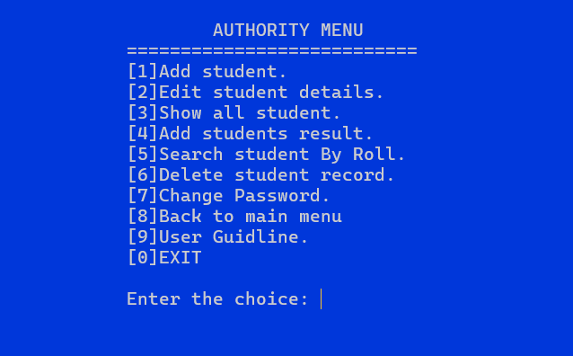
0
THE SYSTEM WILL PROVIDE GREETINGS AND PROVIDE A CHOICE OF ACTION
1
SHOWING THE LIST OF ALL THE ENLISTED STUDENTS IN THE SYSTEM

Slide 18
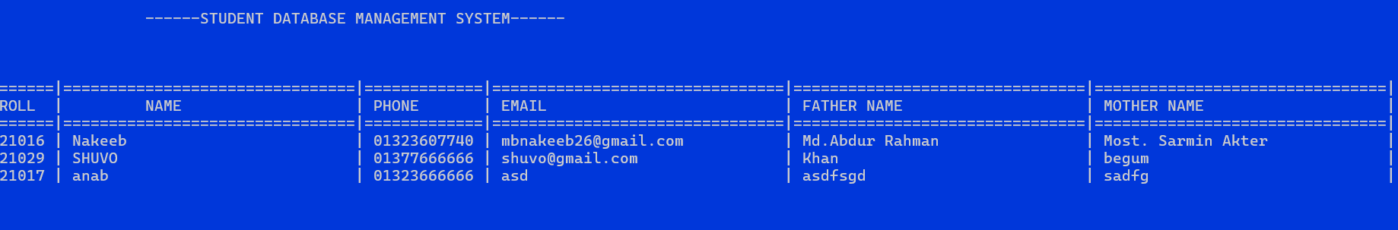
1
SHOWING THE LIST OF ALL THE ENLISTED STUDENTS IN THE SYSTEM
2
0
MAKING A NEW ENTRY OF A STUDENT IN THE SYSTEM
THE SYSTEM WILL PROVIDE GREETINGS AND PROVIDE A CHOICE OF ACTION

Slide 19
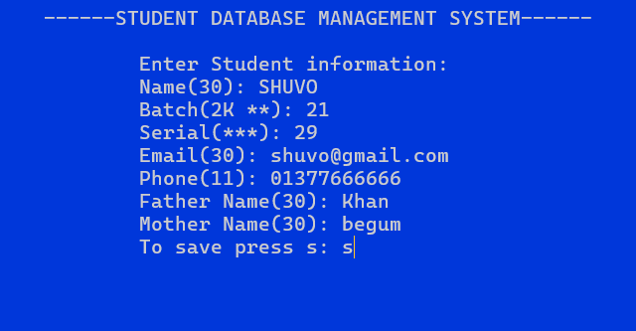
2
MAKING A NEW ENTRY OF A STUDENT IN THE SYSTEM
1
3
SHOWING THE LIST OF ALL THE ENLISTED STUDENTS IN THE SYSTEM
SEAFRCHING A STUDENT BY ENTERING ITS ROLL IN THE SYSTEM

Slide 20
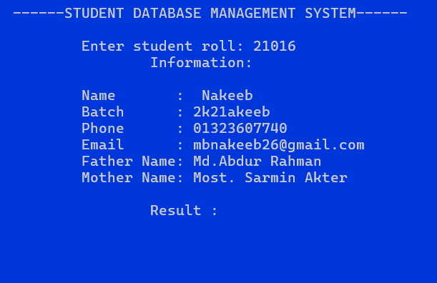
3
SEARCHING A STUDENT BY ENTERING ITS ROLL IN THE SYSTEM
2
4
MAKING A NEW ENTRY OF A STUDENT IN THE SYSTEM
MODIFYING AN EXISTING STUDENT’S DETAILS IN THE SYSTEM

Slide 21
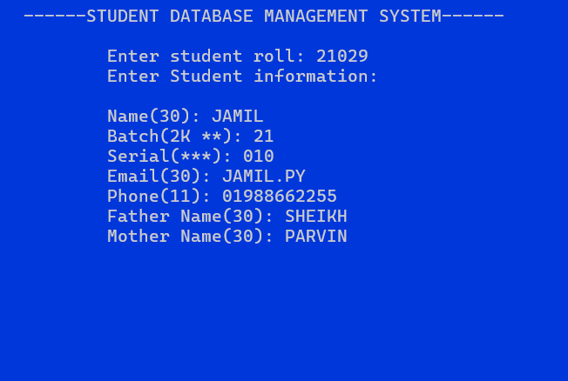

4
MODIFYING AN EXISTING STUDENT’S NAME IN THE SYSTEM
3
5
SEAFRCHING A STUDENT BY ENTERING ITS FULL NAME IN THE SYSTEM
DELETING AN EXISTING STUDENT FROM THE SYSTEM

Slide 22
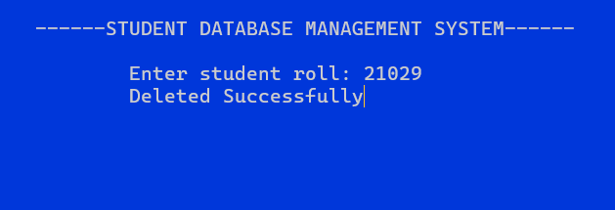

5
DELETING AN EXISTING STUDENT FROM THE SYSTEM
4
MODIFYING AN EXISTING STUDENT’S NAME IN THE SYSTEM

Slide 23


